Slide 1

Electricity Forecasting
DATA 5100 01 23 FQ Foundations of Data Science
Guided By:
Elio Zhang

Slide 2
Table of contents
1. Introduction
1.1 Background
1.2 Goal
2. Methodology
2.1 Data Preprocessing
2.2 EDA
2.3 Machine Learning Implementation
2.4 Comparison Between RMSE and R SQUARED Values for Different Models
3. Results
4. Conclusion

Slide 3
1.1 Background
This project aims to enhance the hedge fund's decision-making in the volatile energy market by improving its hourly load forecasting.
Recognizing the complexities of predicting energy consumption, the project leverages advanced data science and machine learning to create a precise predictive model.
The goal is to provide traders with a competitive edge, allowing them to proactively optimize positions based on accurate hourly load predictions.
While acknowledging the value of existing models, the project seeks to refine and optimize them to better align with the dynamic energy market, ultimately contributing a robust forecasting tool for strategic decision-making.

Slide 4
1.2 GOAL
This project enhances hourly load predictions in a hedge fund using advanced data science and machine learning.
The goal is to empower traders with accurate insights, ensuring a competitive edge in the dynamic energy market. The project aims for immediate improvements and ongoing adaptability to changing market conditions.
Develop and implement optimized trading strategies based on the accurate hourly load predictions, enhancing the hedge fund's decision-making processes and maximizing profit potential.
Contribute to sustainability goals by optimizing energy consumption patterns, aligning trading strategies with environmentally friendly practices, and promoting responsible energy use within the market.

Slide 5
2.1 Data Preprocessing
The dataset was streamlined for improved model training by selecting essential columns ('Date', 'Hr_End', 'RT_Demand', 'Dry_Bulb', 'Dew_Point’).
The 'Date' column was standardized to datetime format, and new temporal features ('Day_of_Week', 'Day_of_Month', 'Month') were created.
Additional columns were added to the dataset named 'Dry_Bulb_Squared', 'Dew_Point_Squared' and 'Dry_Bulb_Dew_Point_Interact'. Squared values are introduced in a dataset to capture non-linear relationships, address curvature, represent interaction effects, and enhance the model's ability to discern patterns, especially in regression analysis.
These steps aim to focus on key variables and enhance the dataset's temporal insights, preparing it for analysis and model development.

Slide 6
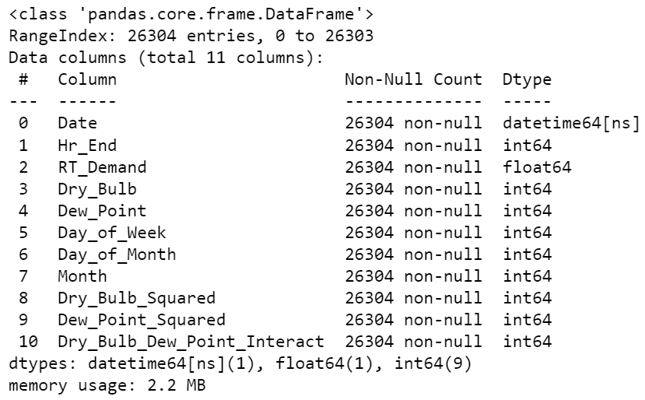
2.2 EDA
Data information:

Slide 7
Data Review
The well-organized dataset, comprising 26,304 rows and 14 columns, encompasses diverse data types such as dates, times, and energy-related components.
The absence of missing values in the dataset ensures data completeness and reliability, providing a solid foundation for accurate predictive modeling.
The memory efficiency of the dataset at 33.8 KB facilitates seamless data handling and manipulation throughout the preprocessing and modeling stages.
Temporal information encoded in the dataset, including datetime and hour details, presents an invaluable resource for predicting future electricity demand with a temporal context.
The inclusion of energy demand data as the target variable establishes a clear objective for the predictive modeling task, focusing on forecasting electricity consumption.
The structured nature of the data, coupled with its temporal components and diverse variables, sets the stage for comprehensive preprocessing and feature engineering in the subsequent methodology.
The training dataset's meticulous composition and robust characteristics lay the groundwork for developing a predictive model capable of capturing intricate patterns and relationships within the energy market.

Slide 8
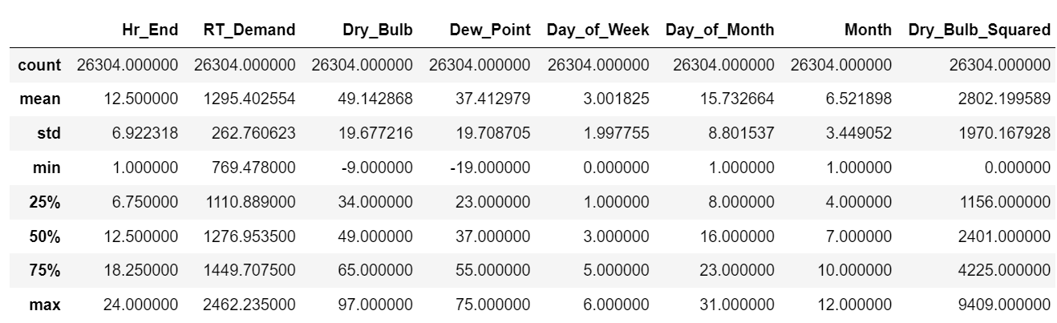
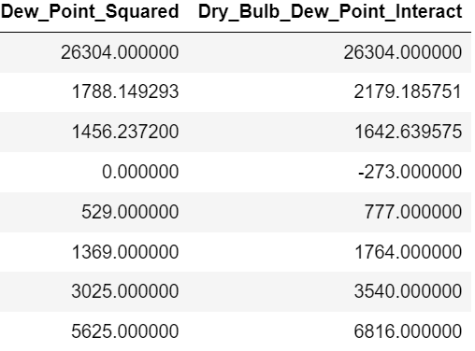
Data Description:

Slide 9
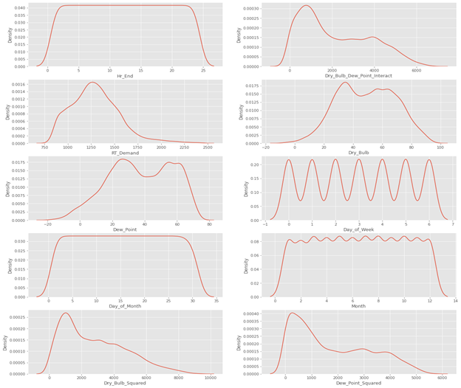
Data Distribution:

Slide 10
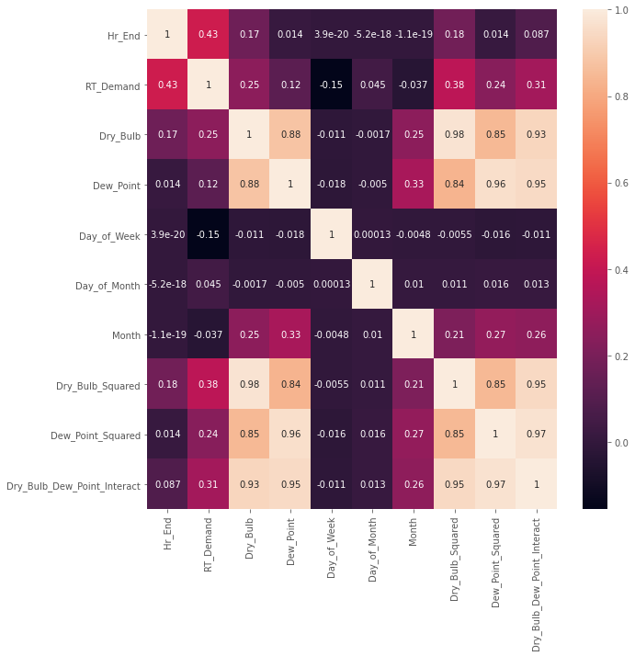
Data Correlation:

Slide 11
2.3 ML Implementation Modelling
We trained various models on preprocessed data, including linear regression, random forest regressor, decision tree regressor, bagging with random forest, bagging with decision tree regressor, and gradient boosting.
Inertia terms like Dry Bulb Squared, Dew Point Squared and Dew Point Interaction were integrated for complex relationships.
Bagging with Decision Tree Regressor and Random Forest Regressor outperformed others with RMSEs of 48.97 and 48.87, respectively. Bagging with Random Forest (RMSE 51.13) and Gradient Boosting Regressor (RMSE 57.62) also performed well.
Decision Tree Regressor and Linear Regression had the worst performance with RMSEs of 66.98 and 167.72, respectively.
In summary, ensemble methods like Bagging and Random Forest are effective, with Bagging with Decision Tree Regressor being the top-performing model.

Slide 12
2.5 Comparison between rmse and r SQUARED VALUES For DIFFERENT MODELS
Models | RMSE | R-Squared
Random Forest Regressor | 48.873076 | 0.966574
Bagging with Decision Tree Regressor | 48.967553 | 0.966445
Bagging with Random Forest | 51.134699 | 0.963409
Gradient Boosting Regressor | 57.62477 | 0.953531
Decision Tree Regressor | 66.979827 | 0.937219
Linear Regression with Bagging | 167.716457 | 0.606364
Linear Regression | 167.718436 | 0.606355

Slide 13
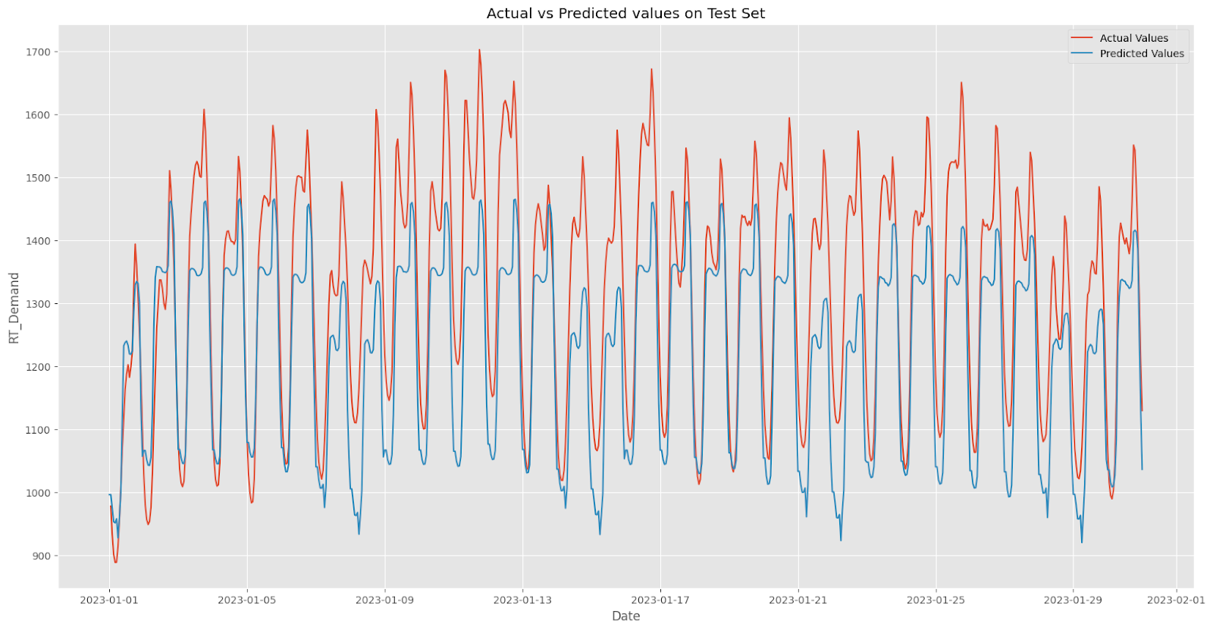
Results
Random Forest regression

Slide 14

Results
Bagging with Decision Tree Regressor

Slide 15
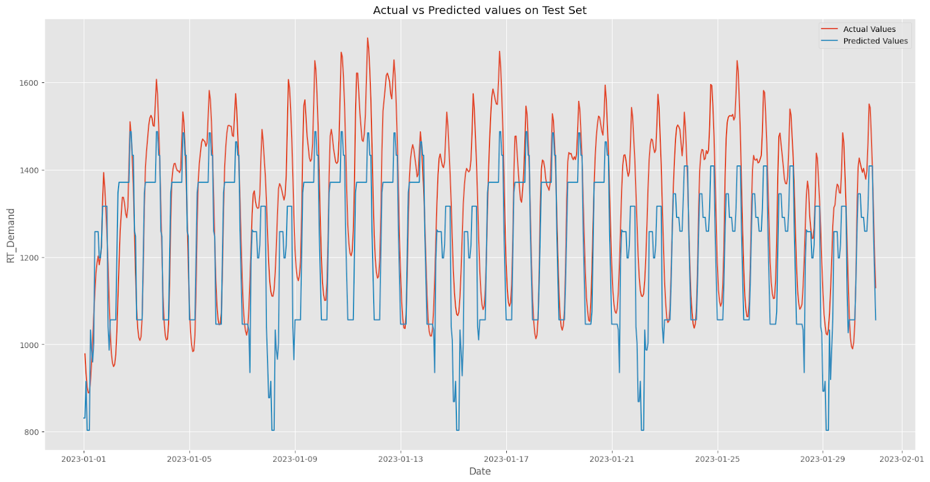
Results
Decision Tree Regressor

Slide 16
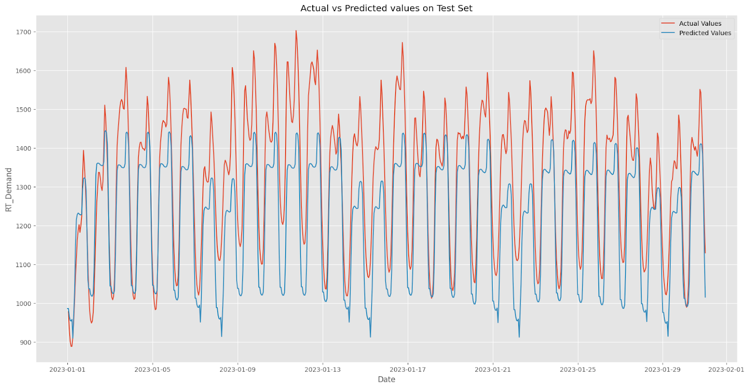
Results
Bagging with Random Forest

Slide 17
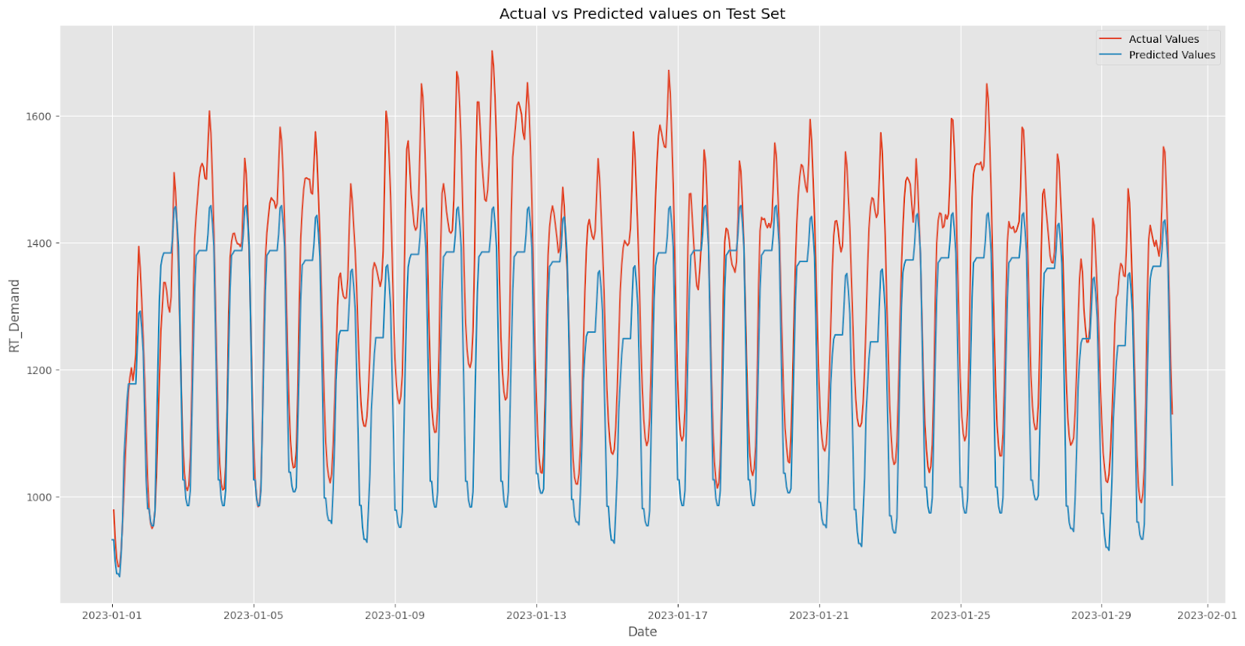
Results
Gradient Boosting Regressor:

Slide 18
Conclusion
Random Forest Regression and Decision Tree Regressor with Bagging consistently outperform other models, showcasing superior predictive accuracy.
These ensemble methods excel in capturing complex patterns, with Random Forest mitigating overfitting through multiple trees and with Bagging we have tried to enhance the performance by combining outputs from varied training subsets.
Their success stems from addressing overfitting and capturing diverse dataset patterns.
These models emerge as reliable and recommended choices for accurate energy demand predictions, demonstrating adaptability and robustness across scenarios.
Their ensemble nature proves effective in handling intricate dataset dynamics, making them top-performing solutions in energy demand prediction.

Slide 19
THANK YOU

